Slide 1

Natural disaster assessment using AI
NASA Space Apps 2023, Morug Melog Team
.
Natural disasters provide many challenges to governments and rescue services. Currently assessment of natural disasters is done manually or with an AI to a very limited extend. We propose AI powered analytics tool that help to provide humanitarian assistance and disaster recovery.

Slide 2
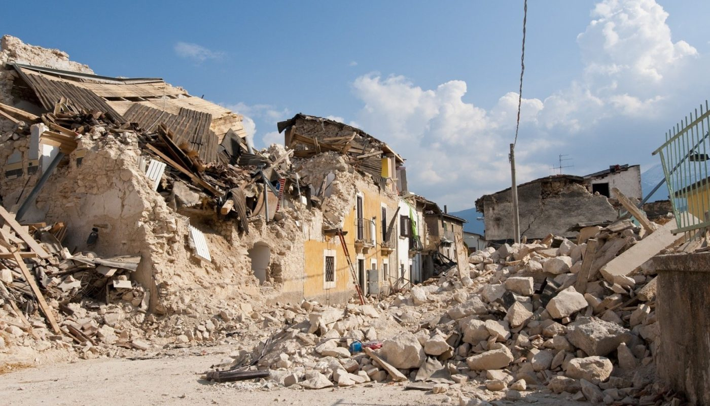






Our GeoAI App…
NASA Space Apps 2023, Morug Melog Team
… provides quickest way to assess damage after natural disaster.
… leverages drone, satellite and SAR data
data fusion
works during any weather conditions
drones are versatile
… pinpoints destroyed buildings and people that are potentially trapped in them.
… provides optimal
routing for emergency services
avoiding destroyed/flooded roads
… is designed for emergency management

Slide 3





Real Life Implementation
1. Collect Data
2. AI Analysis
3. Decision making
NASA Space Apps 2023, Morug Melog Team
Airbus SAR Satellites
Drones
Model fine-tuned on natural disaster dataset
Automated description and annotation
Best route to given destination
Any weather and terrain conditions
Handling other disasters in the future!

Slide 4

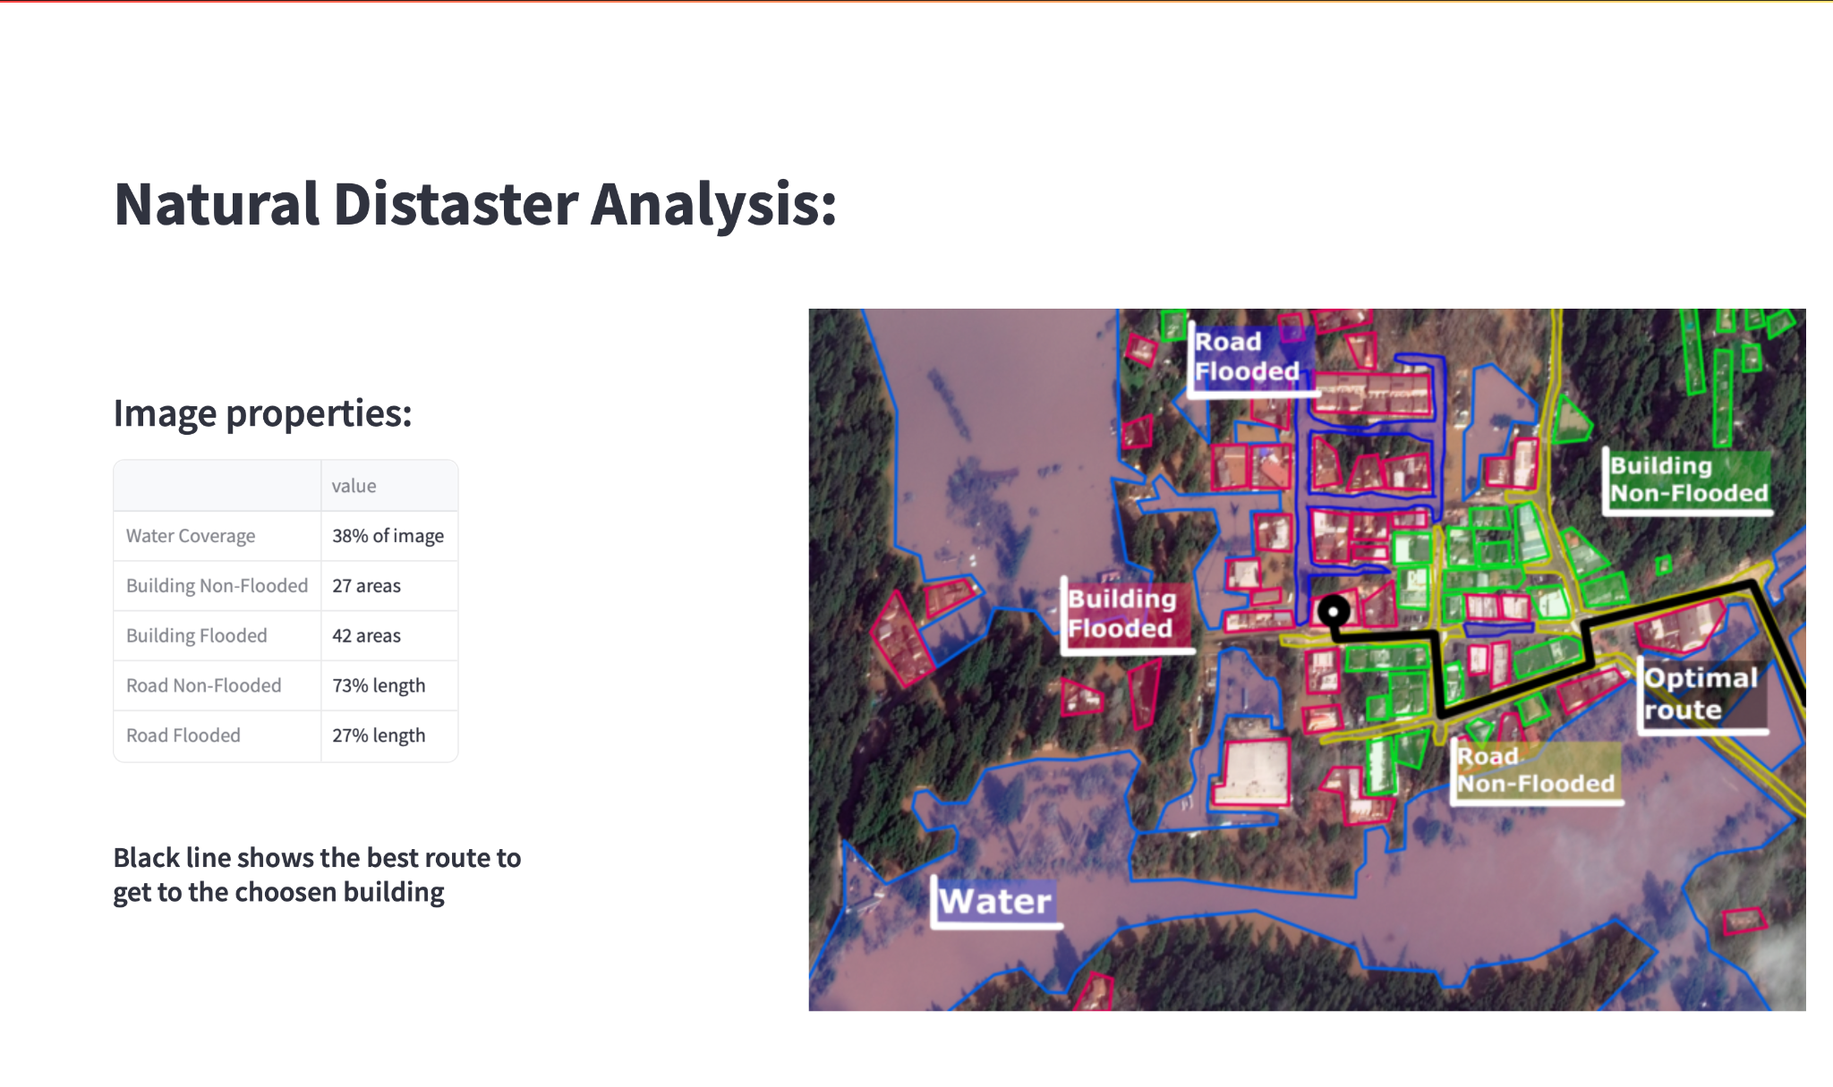



Clear information about the disaster area
NASA Space Apps 2023, Morug Melog Team
We propose the web app, that provides clear information about the state of the area, by supplying:
State of houses
State of roads
Flooded area
Optimal route
Drives critical decision making

Slide 5
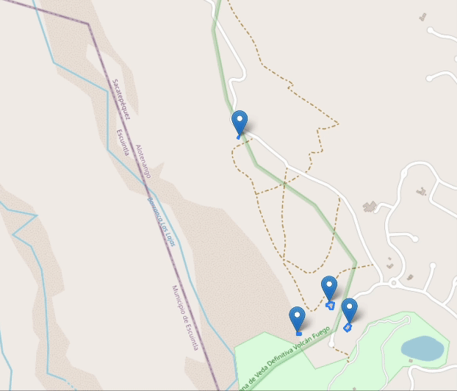
Foundation model fine-tuning to assess building damage after natural disasters
NASA Space Apps 2023, Morug Melog Team
Undisturbed.
MINOR DAMAGE
NO DAMAGE
Building partially burnt, water surrounding the structure, volcanic flow nearby, roof elements missing.
MAJOR DAMAGE
Structure is scorched, completely collapsed, partially or completely covered with water or mud.
Partial wall or roof collapse, encroaching volcanic flow, or the structure is surrounded by water or mud.
DESTROYED

Slide 6
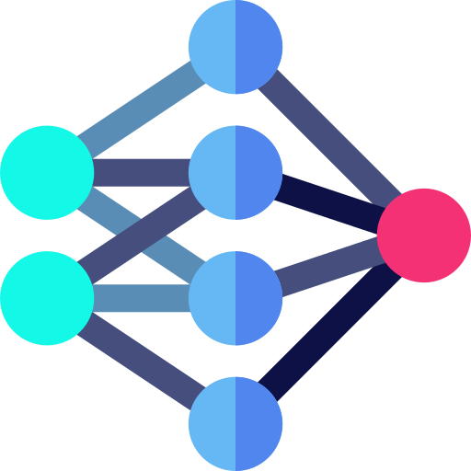
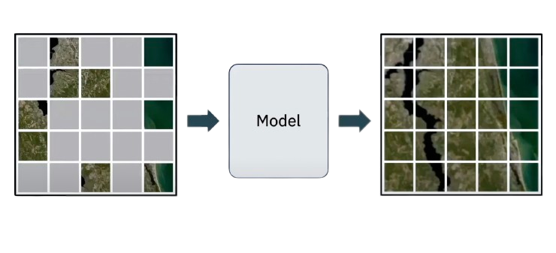

Model details
NASA Space Apps 2023, Morug Melog Team
Model based on transformer architecture.
Our model achieves 94.34% accuracy on a test set after fine-tuning!
We leverage self-supervised pre-training reducing the amount of needed labeled data.
input
output

Slide 7
Conclusions
NASA Space Apps 2023, Morug Melog Team
Our solution:
Completely new product that takes to the next level emergency management.
for governments
for rescue services
Uses ML to automatically find destroyed buildings and infrastructure.
Provides valuable information about natural disasters in the most crucial moments.
Enables quick response to ones that need it the most.
Mitigates analytical bottleneck in the post-disaster workflow.
Ready to handle new types of disasters.
The goal is to save lives
Our goal is to save lives!

